Slide 1
Demographics and Clinical Presentation of Sexual Difficulties in Youths
Dr Saumya Ranjan Mishra
Executive Editor- Indian Journal of Health, Sexuality & Culture
Indian Institute of Sexology Bhubaneswar

Slide 2
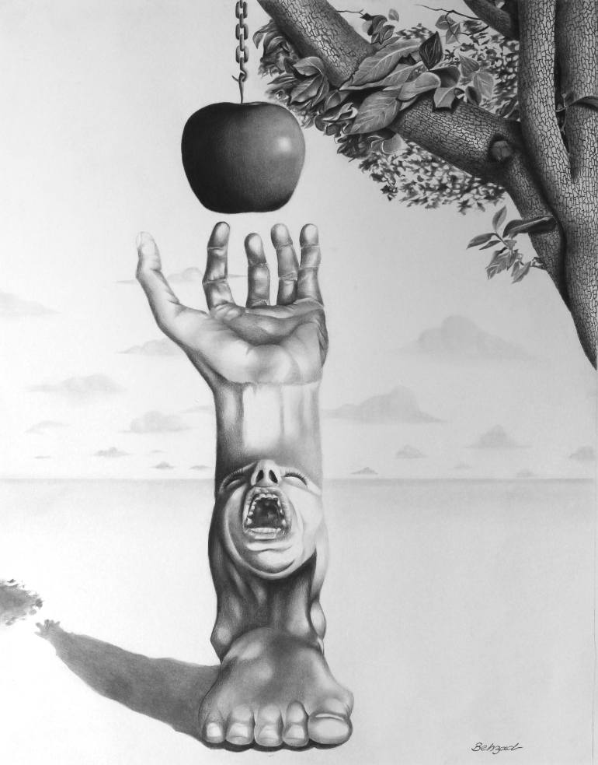
Outlines of presentation
Age
Gender
Marital status
Residential status
Sociocultural factors
Education

Slide 3
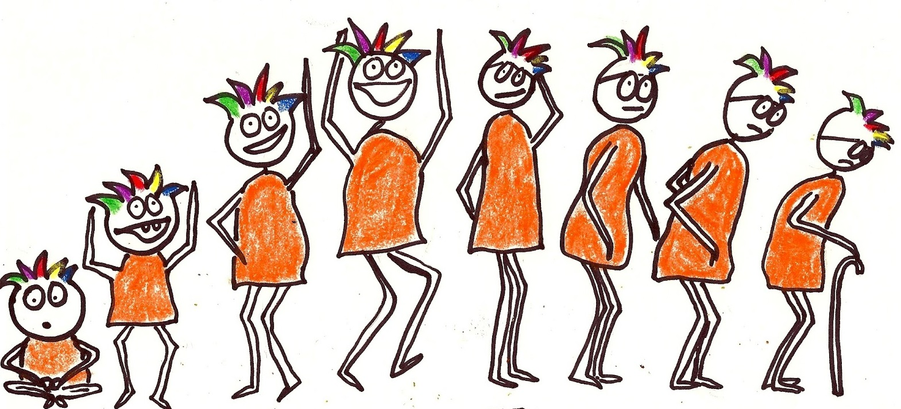
Across ages
Congenital anomalies-phimosis
Child sexual abuser-victim- re-enacts abuse, aggressive sexual behaviours, sexual addictions- sexual fear
Gender identity disorder- frustrations and anxiety during ‘Coming out’
Puberty related concerns- late menarche, menstruation difficulties
Notes:
Too crowded slides

Slide 4
Across ages
Early and successive pregnancies, abortion
Vaginal dryness-menopause
Fatigue & erectile dysfunction - diabetes mellitus
Prolonged refractory period
Notes:
Too crowded slides

Slide 5
Male Vs Female
Performance anxiety
Erectile dysfunction
Premature ejaculation
Nocturnal emission, masturbation
Impaired ejaculation
Excessive sexual preoccupation

Slide 6
Male Vs Female
Vaginismus
Dyspareunia
Lack of sexual desire- pregnancy, parturition, breastfeeding-frigidity- taboo
Infertility- peaks between 20-24 years of age
Menopause- hot flashes, mood disturbances, headaches and sleep disturbances
Non-specific somatic symptoms- headache
Less total satisfaction- orgasm+commitment
Difficulty in adjustment with partner

Slide 7
Married vs Unmarried
Erectile problems -premature ejaculation vs nocturnal emission- passing semen in urine- masturbation
Altered sexual preferences
Spousal abuse vs rejection of potential sexual partner
Notes:
Please add references in the end of the slide for easy referencing

Slide 8
Rural vs Urban
Dhat syndrome- rural poor
Internet sex addiction-
(a) cyber-sexual addiction (compulsive use of websites for cyber-porn)
(b) cyber-relationship addiction (over-involvement in online relationships)

Slide 9
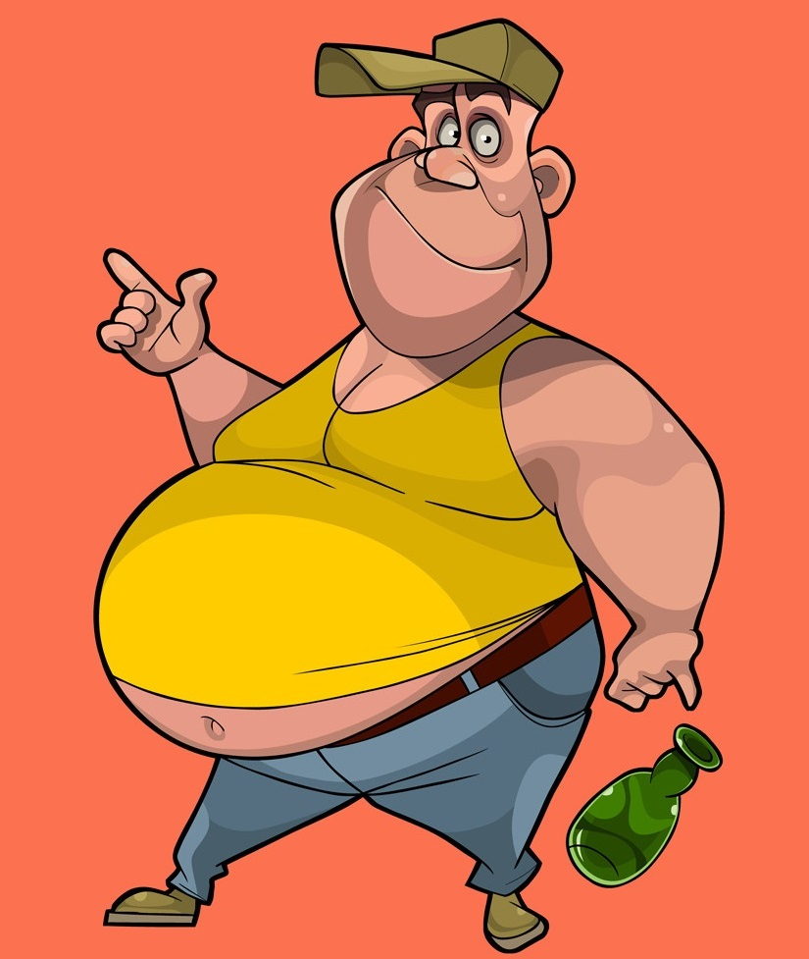
Sociocultural factors
Ascetic syndrome-morality- psychosocial withdrawal, severe sexual abstinence
Women are seen as temptresses and suckers of vital energy - anxiety
Koro syndrome - penis is retracting into abdomen

Slide 10
Dhat Syndrome
Young, poor, rural and from family with conservative attitudes towards sex
Excessive loss of semen in sleep, with urine, masturbation, hetero/homosexual sex.
Excessive worry, depression, trouble sleeping, thoughts of self harm-suicide
Anger, irritability
Mental weakness- trouble concentrating, poor memory
Bodily weakness
Aches and pain-during sexual intercourse

Slide 11
Female Dhat Syndrome
Vaginal discharge, generalized weakness, back ache
Less educated rural women
Possible causes- poor personal hygiene, lack of good nutrition, excess physical exhaustion, anxiety in sexual activities
Relationship problem, domestic violence, coerced sexual activity

Slide 12
Education
Dhat syndrome is seen across all levels of educational background
Duration of sexual act, sexual position
Amount and texture of semen
Abnormal shape and size of penis, testis, vagina, breast
Virginity

Slide 13
To conclude
Sex is often attempted and not understood.
This also holds true for treatment of sexual difficulties.
Communication is the key.

Slide 14
Thanks

