Slide 1


Sexuality in young people: issues and conflicts
‘Sex In Mind’- Dealing with young people in OPD
Miss. Deblina Roy,
Department of Psychiatry, KGMU, Lucknow, U.P

Slide 2
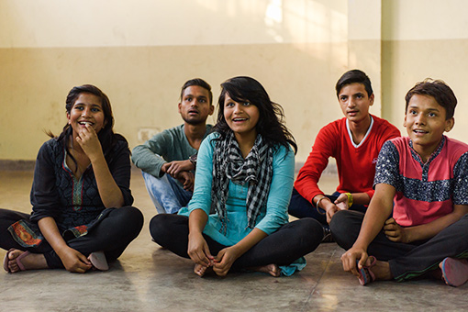
Introduction
Adolescents cover 1.2 billion across the globe (17% of the world population).
70 % of them live in Developing countries.
These lead to diverse issues in their sexual functioning.
US Census Bureau International Data Base (IDB) World Population by Age and Sex. 2014. [Last accessed on 2014 Jul 27]. Available from: http://www.census.gov/cgi-bin/broker .

Slide 3
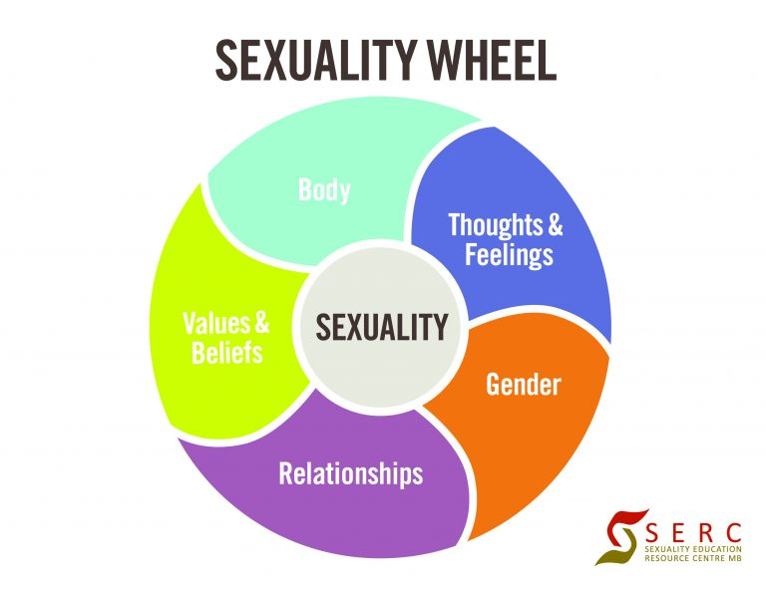
Sexuality in adolescents
Factors effecting their interpretation of sexuality are:
Migration,
Urbanization
Technology
Education
Culture
Sexuality Education and Research Center UK

Slide 4


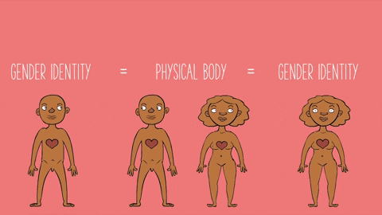
Development of sexuality
Infancy
Toddlerhood (gender identity Established )
School age
Puberty
Maturation
Gender sexual conformity
Kar, S. K., Choudhury, A., & Singh, A. P. (2015). Understanding normal development of adolescent sexuality: A bumpy ride. Journal of human reproductive sciences, 8(2), 70–74. doi:10.4103/0974-1208.158594

Slide 5
Developing sexuality
Adolescence
Early (10-13yr
Middle(14-16yr)
Late (17-19yr )
Sexual Maturation and development of normal sexuality , colouring the whole personality.
Conflicts of gender identity are at the utmost severity.

Slide 6

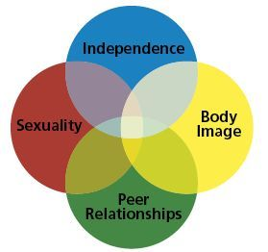
young Girls
Mean age at menarche is now 12–13 years , but is falling in developing countries.
Pre Menstrual Syndrome.
Viner RM, Allen NB, Patton GC. Puberty, Developmental Processes, and Health Interventions. In: Bundy DAP, Silva Nd, Horton S, et al., editors. Child and Adolescent Health and Development. 3rd edition. Washington (DC): The International Bank for Reconstruction and Development / The World Bank; 2017 Nov 20. Chapter 9. Available from: https://www.ncbi.nlm.nih.gov/books/NBK525269/ doi: 10.1596/978-1-4648-0423-6/pt2.ch9

Slide 7

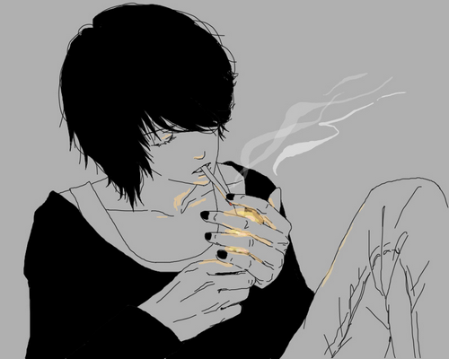


Issues in Girls
Accelerated puberty brings about risks for: early sexual activity
Violence
Abuse
psychosocial stress
Peer pressure
Substance use
Teenage pregnancy
Depression
Anxiety
Deliberate self harm
Carrier related stress

Slide 8

Adolescent Boys
Adrenarchy mean age is quite stable up to 13 years throughout the world.

Slide 9
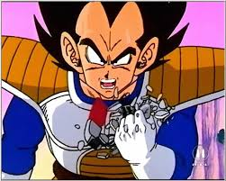

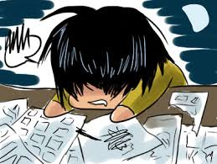

Challenges during adolescence
Among Boys
Aggression
Peer pressure
Substance use
Myths and misconceptions about sexuality.
Psychosocial stressors.
Anxiety ,depression
Delinquency
Self harm
Carrier related stress.

Slide 10
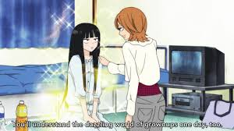
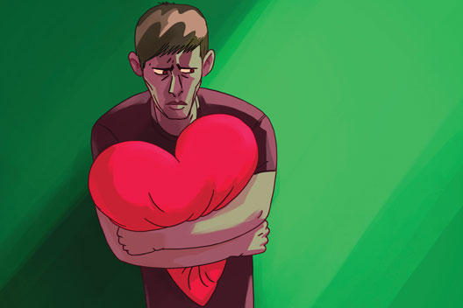
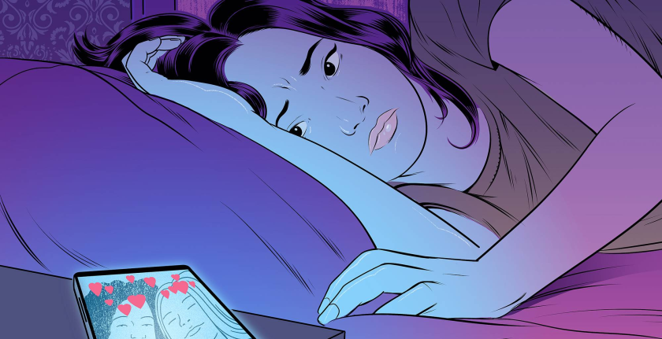

Common Challenges among Girls’ and Boys
Myths and misconceptions about sexuality.
Access to information
Cultural beliefs and taboos
Early exposure or lack of exposure.
Lack of access to sexual health services

Slide 11
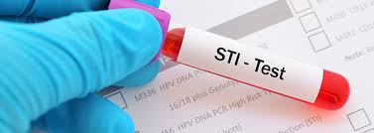
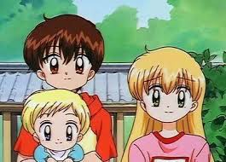
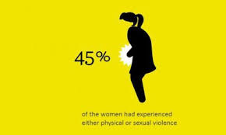
Common sexual health problems faced by Youth in the world
High prevalence of sexually transmitted infections*.
#Teen age pregnancy 1 million girls under 15 give birth every year—most in low- and middle-income countries.
#Child marriages: 39 000 every day. More than 140 million girls will marry between 2011 and 2020.
Sexual dysfunction
Sexual violence
Culture bound syndromes.
Pornography addiction.
Dhat Syndrome
*Kumarasamy, N., Balakrishnan, P., Venkatesh, K. K., Srikrishnan, A. K., Cecelia, A. J., Thamburaj, E., … Mayer, K. H. (2008). Prevalence and incidence of sexually transmitted infections among South Indians at increased risk of HIV infection. AIDS patient care and STDs, 22(8), 677–682. doi:10.1089/apc.2007.0166
#WHO report on sexyal health

Slide 12
Major issues in sexual health
Lack of sex education
Peer information and misinformation
Dhat Syndrome
Leucorrhoea
Pornography and internet addiction
Pre menstrual syndrome
Impulsivity and high risk behaviour

Slide 13
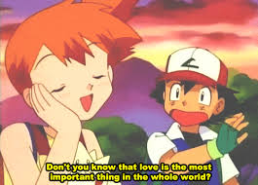
Lack of proper sex education
Leads to creation and propagation of myths and misconceptions.
High risk sexual behaviour
Teenage pregnancy
Sexually transmitted infections and lack of help seeking behaviour.
Excessive anxiety related to sexual activities

Slide 14



Peer information and misinformation
The Youth mainly try to gather information from their peers .
Social taboo regarding asking questions.
Access to wrong information is profound.
Exploitation.

Slide 15

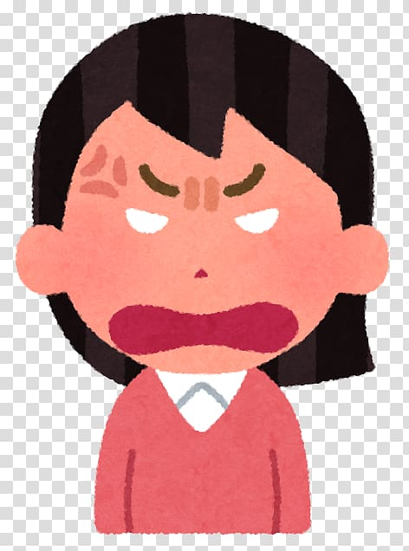
Dhat Syndrome
Culture bound syndrome around South East Asia.
High prevalence of this syndrome in psychosexual OPD.
Significant distress and associated anxiety and depression.
Dire need for follow up and structured counselling for managing these problems

Slide 16

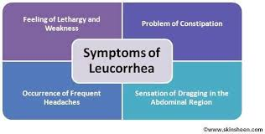
Leucorrhea
Confusing entity among the women
Indian and South Asian context often not associated with RTI or STI.
More commonly reported in rural setting.
Creates similar signs and symptoms like Dhat syndrome in Males.

Slide 17





PMS (Pre Menstrual Syndrome)
Notes:
acne, tender breasts, bloating, feeling tired, irritability, and mood changes.

Slide 18
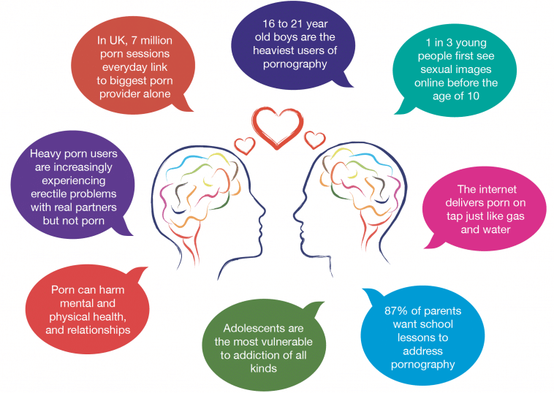
Pornography addiction

Slide 19


Results of sexual violence
Short term effects | Long term effects
Feelings of guilt and shame loneliness and sadness Confusion Anger Low self esteem Dissociation Fear Depression Hatred | Promiscuity Anxiety Eating disorders Body image issue Lifestyle changes Violence Substance Use PTSD Rape trauma Syndrome

Slide 20
Characteristics of services
Sexual health services for youth
Sensitive
Non judgemental
Multidisciplinary
Accessible
Educative
Facilitative
Integrative services
Protective

Slide 21
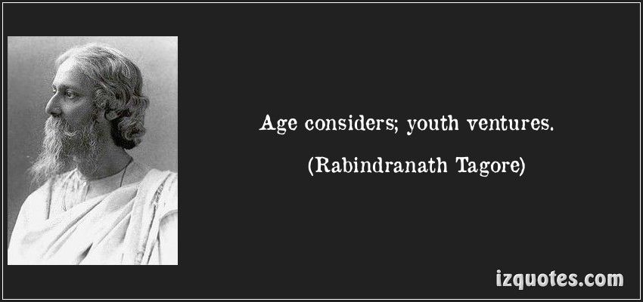
conclusion

Slide 22


Thank you

