Slide 1
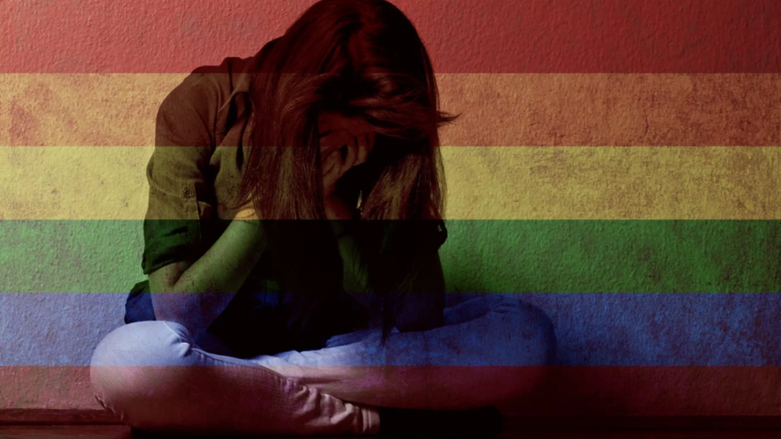
Violence Against LGBTQ
8th International Conference on Victim Assistance
Deblina Roy
Assistant Professor(Psychiatric Nursing)
Department of Psychiatry, KGMU.
Representing : Indian Institute of Sexology Bhubaneswar

Slide 2
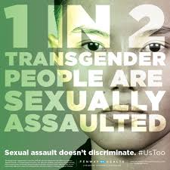
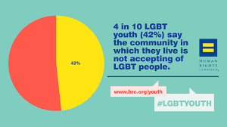
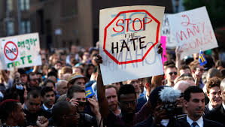
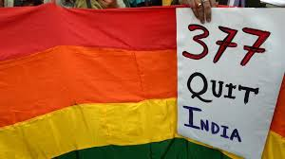
Introduction
Notes:
Violence the word itself puts the people perceiving it at unease. It is very difficult to imagine how traumatizing the experience can be for the recipient of it. It is so hard to imagine that the most advanced beings on the planet Earth, are unable to tolerate same beings just because of a different sexual orientation. The statistics say that :

Slide 3
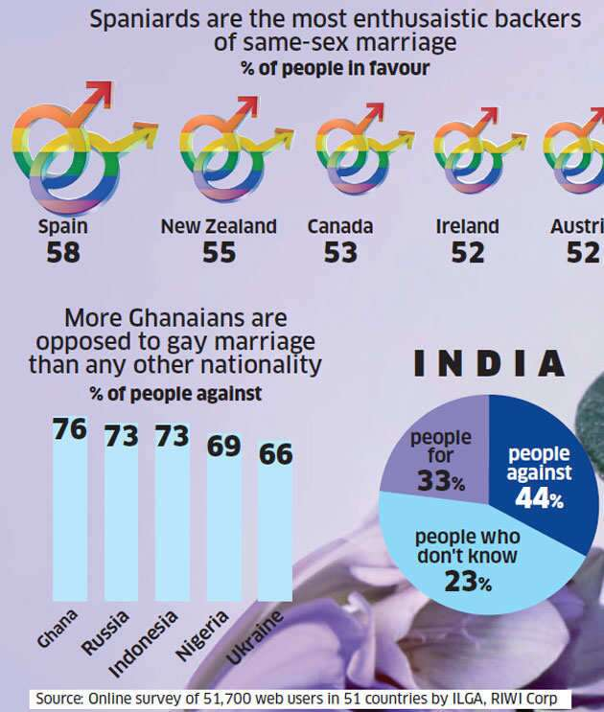
Demography
Brazil has been a country to report the greatest number of murders of people belonging to LGBTQ amounting alleged homicide and hate crimes against the LGBTQ community.
The FBI of USA also reported that homophobic murders constituted of 0.03% of total homicide cases in 2008.

Slide 4
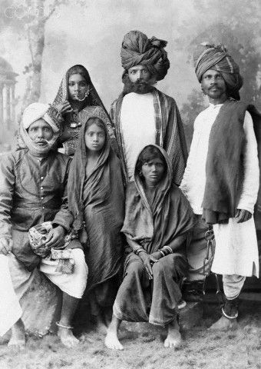
Historical perspectives
Pre colonial India
Colonialism and the world
Colonialism and India
Victorian influence
Morality and sexuality Religion.
Notes:
The civilizations of the ancient times have depicted various sexualities in their art architecture and literature, it that is not the evidence of acknowledgement of these basic variations I don’t know what is. Coming back to the colonial era and European domination unfortunately I would like to state that their was a strong aversion towards the acceptance of LGBTQ. It grew severe with the colonialization and worldwide legislations were passed to morally correct this, distorting associated beliefs and practices.

Slide 5
Psychiatry and homosexuality
Depiction of homosexuality as an abnormality.
Gender identity disorders
Various treatment methods to treat homosexuality
Failed attempts to cure homosexuality
Concluding that homosexuality transgender queer bisexuals are variants of sexuality.
Removal of homosexuality from the ICD 11 and DSM V.

Slide 6
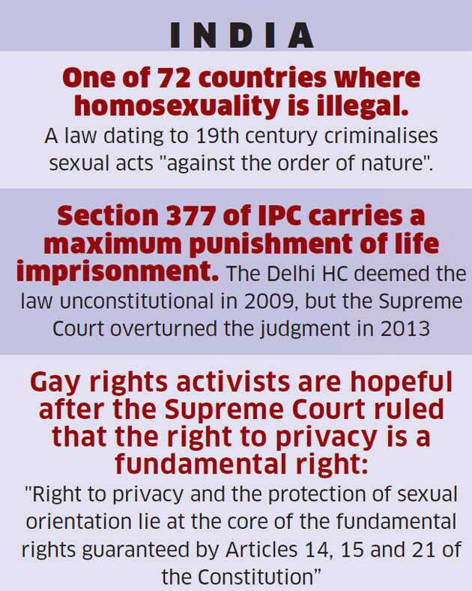
Scenarios and Developments

Slide 7
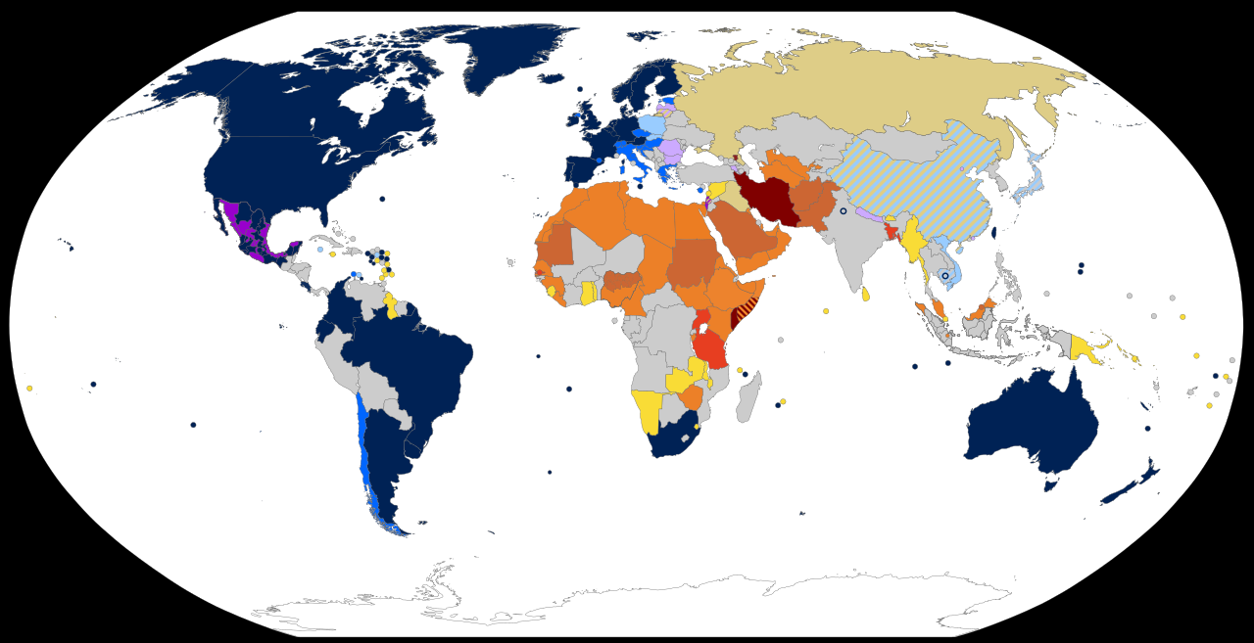
Penalties of being LGBTQ throughout the world
.

Slide 8
Article 377 of IPC
Introduced in 1861 during the British rule of India.
Modelled on the Buggery Act of 1533(based on act by Britain), it makes sexual activities "against the order of nature" illegal.
6 September 2018, the Supreme Court of India ruled
consensual homosexual sex between adults was unconstitutional, "irrational, indefensible and manifestly arbitrary
still holds itself for Forceful sexual activites and sex with minors, non-consensual sexual acts, and bestiality

Slide 9
Landmark right to privacy judgement
Sexual orientation is an essential attribute of privacy.
Discrimination against an individual on the basis of sexual orientation is deeply offensive to the dignity and self-worth of the individual.
Equality demands that the sexual orientation of each individual in society must be protected on an even platform.
The right to privacy and the protection of sexual orientation lie at the core of the fundamental rights guaranteed by Articles 14, 15 and 21 of the Constitution..
"Supreme Court rights old judicial wrongs in landmark Right to Privacy verdict, shows State its rightful place". www.firstpost.com. Retrieved 10 July 2018

Slide 10
Types of offences committed against LGBTQ
Violence against LGBTQ
Gay and trans Bashing
Homophobic violence
Hate crimes
Sexual Harassments
Rape
Judicial biases
Attacks on gay parades
Homophobia on digital and social media

Slide 11
Gay and Trans Bashing
  Gay bashing and gay bullying is an attack, abuse, or assault committed against a person who is perceived by the aggressor to be gay, lesbian, bisexual, or transgender.
  The attack may be physical or verbal.
  This can also include abuse, bullying or assaults perpetrated against a heterosexual person who the attacker perceives to be LGBT.
  This type of violence is basically most common type of violence which has been associated with fatalities across the world.

Slide 12

Typical scenario of gay bashing
Radicalism against LGBTQ within Heterosexuals
LGBTQ person minding their own business
Hatred
Abuses @#$%##
Ideas
Leads to activities

Slide 13
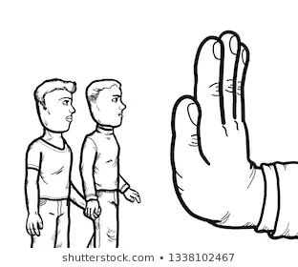
Homophobia
Discriminates people on the basis of their sexual orientation (LGBTQ).
contempt, prejudice, aversion, hatred or antipathy, may be based on irrational fear and ignorance, and is often related to religious beliefs.
Encyclopedia of Interpersonal Violence. SAGE Publications. p. 338. ISBN 978-1452265919. Retrieved December 27, 2014.

Slide 14
Hate crimes
A prejudice-motivated crime which occurs when a perpetrator targets a victim because of their membership (or perceived membership) in a certain social group or race.
called "bias incidents".
World wide incidents of hate crimes are more in LGBTQ communities.
Effects of hate crimes: Depression anxiety disorders and PTSD leading to globally increased burden of care and health care costs. Creates a feeling of generalized terror and fear among the victims.

Slide 15
Hate Crimes
physical assault
damage to property,
Letters (e mails)
bullying,
harassment,
verbal abuse or insults
mate crime
offensive graffiti

Slide 16
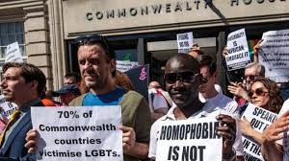
Judicial Biases
There have been evidences many perpetrators/ criminals who have committed atrocities towards the LGBTQ community have often got released or punished leniently.
Release of the murderer in Stanley Park USA man slaughter, Canadian MLA Spencer Herbert said "It's pretty disturbing that somebody that [kills] a person in cold blood gets out very quickly….”
many more such judgements, incidents, have happened in Russia, Iran, Brazil and other countries.
Gay community troubled by release of killer in Stanley Park death". CBC News. 5 February 2009

Slide 17

Actions to curb violence and provide respite to LGBTQ
Legislation
Hate crime law. A recent survey reports, 68% of the LGBTQ community supports the formation of legislation against hate crimes.
Creation of safe spaces for people belonging to LGBTQ.
Unbiased registration of report for any of the violence or threats.
Creating easy hustle free reporting process and procedure.
Expertise development and advanced training of investigators in cases of violence against LGBTQ.

Slide 18
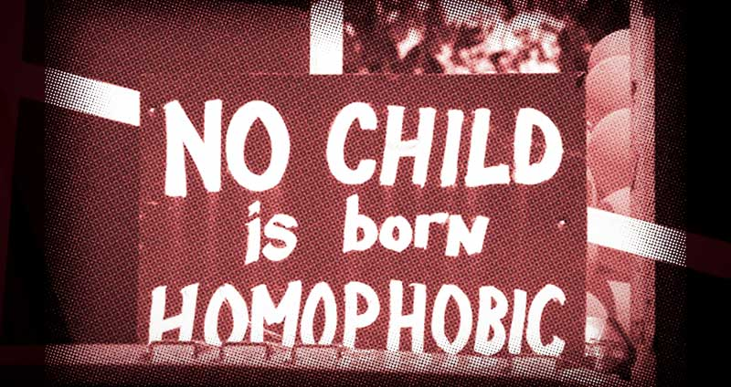
Cont..
Creation of standard protocols for action in such crimes.
Case-auditing and experience sharing workshops for the investigators, and associated people.
Inclusion of social and medical scientists and researchers while caring for the victims.
Sensitizing , teachers , professors , students, offices, workplaces, educational institutes , factories , companies, house holds and communities regarding the violence and encouraging them to report and take actions

Slide 19
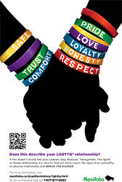
What is the way forward?
What makes us HUMAN?
What does the civilization teach us?
Love, Empathy, acceptance, sharing.
live and let live.

Slide 20
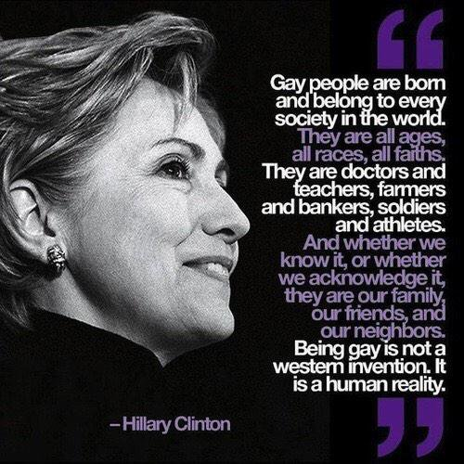
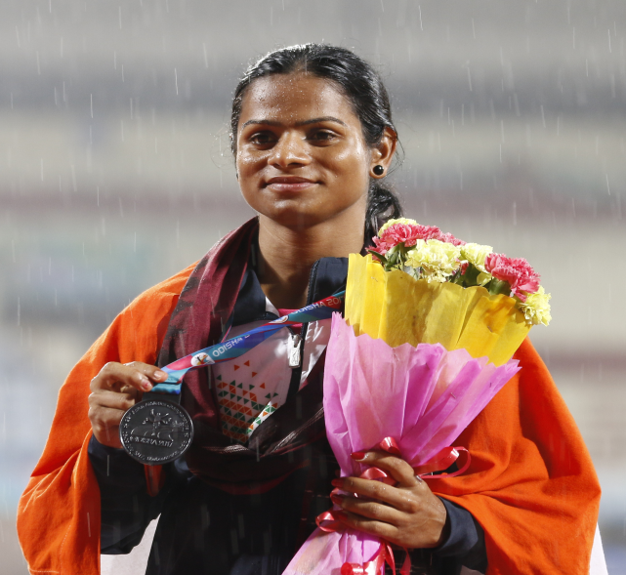
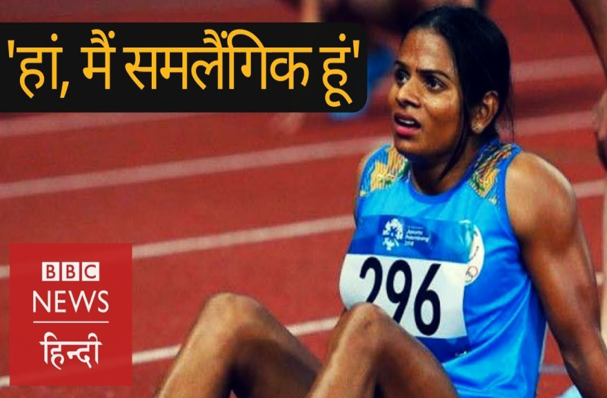
Conclusion

Slide 21

Discussion

Slide 22
Contact information regarding Sexual health Issues.
Indian Journal of Health Sexuality and Culture.
roy.deblina001@gmail.com
sexualityinfo@gmail.com
Editor IN chief Dr. Sujit Kr. Kar.
Associate Professor KGMU Department of Psychiatry.
E mail: drsujita@gamil.com
Executive Editor: Dr. Saumya Ranjan Mishra
E mail: dr.srmishra@gmail.com.

Slide 23


